Slide 1
Union-Find
A data structure for maintaining a collection of disjoint sets
Course: Data Structures
Lecturer: Uri Zwick
March 2008

Slide 2
Union-Find
Make(x): Create a set containing x
Union(x,y): Unite the sets containing x and y
Find(x): Return a representative of the
set containing x

Slide 3
Union Find
make
union
find
O(1)
O(α(n))
O(α(n))
a
b
c
Amortized
d
e

Slide 4
Fun aplications: Generating mazes
make(1)
1 | 2 | 3 | 4
5 | 6 | 7 | 8
9 | 10 | 11 | 12
13 | 14 | 15 | 16
make(2)
…
make(16)
find(6)=find(7) ?
union(6,7)
find(7)=find(11) ?
union(7,11)
…
Choose edges in random order and remove them if they connect two different regions

Slide 5
Fun aplications: Generating mazes
1 | 2 | 3 | 4
5 | 6 | 7 | 8
9 | 10 | 11 | 12
13 | 14 | 15 | 16

Slide 6
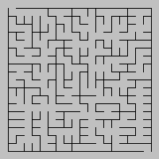
Generating mazes – a larger example
n
Construction time -- O(n² α(n²))

Slide 7
More serious aplications:
Maintaining an equivalence relation
Incremental connectivity in graphs
Computing minimum spanning trees
…

Slide 8
Union Find
Represent each set as a rooted tree
Union by rank
Path compression
p[x]
x
The parent of a vertex x is denoted by p[x]
Find(x) traces the path from x to the root

Slide 9
Union by rank
r+1
r₂
r
r
0
r₁
r₁< r₂
Union by rank on its own gives O(log n) find time
A tree of rank r contains at least 2^{r} elements
If x is not a root, then rank(x)<rank(p[x])

Slide 10
Path Compression

Slide 11
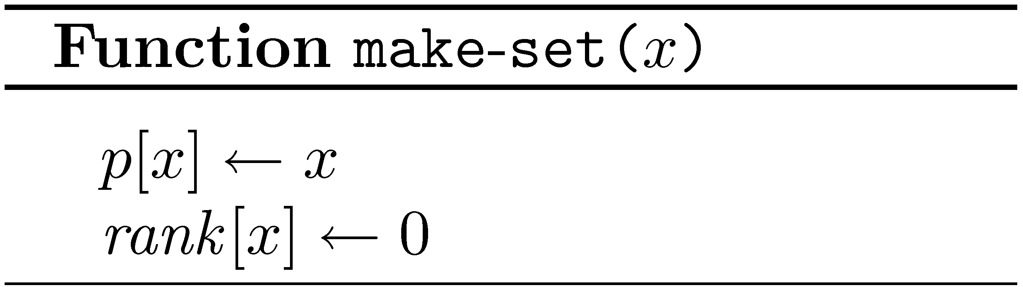
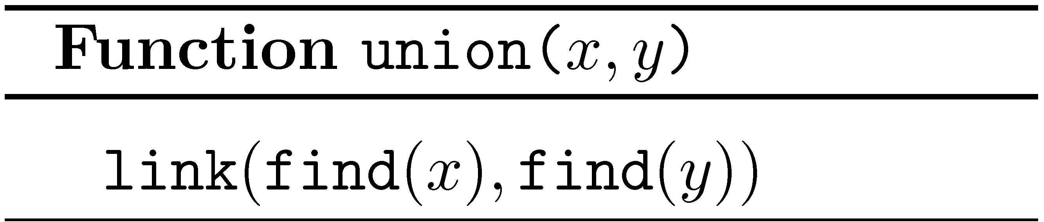
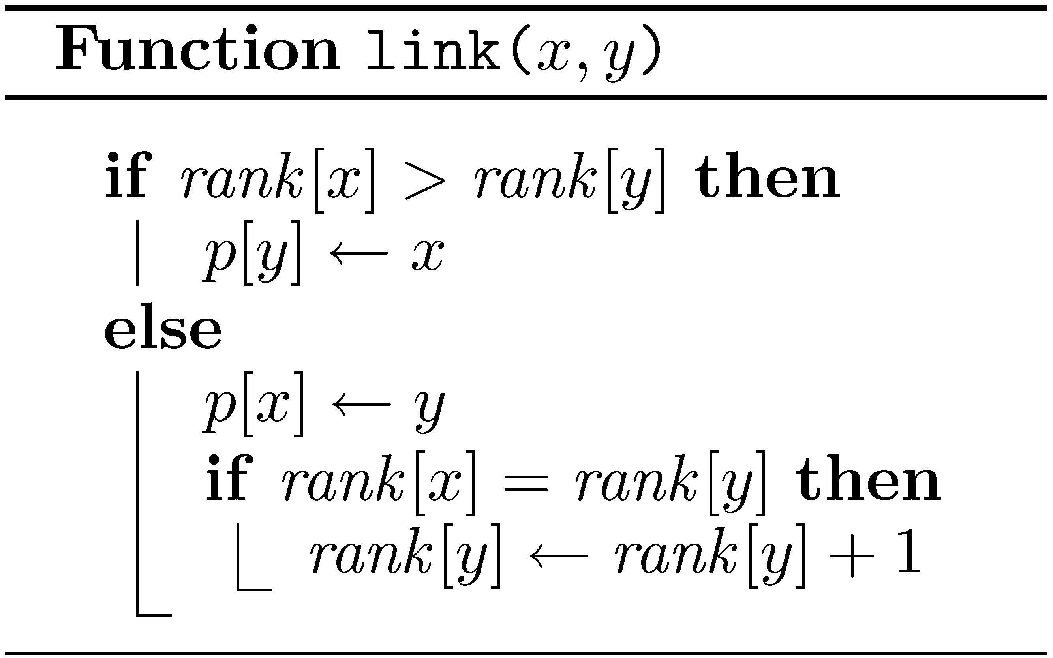
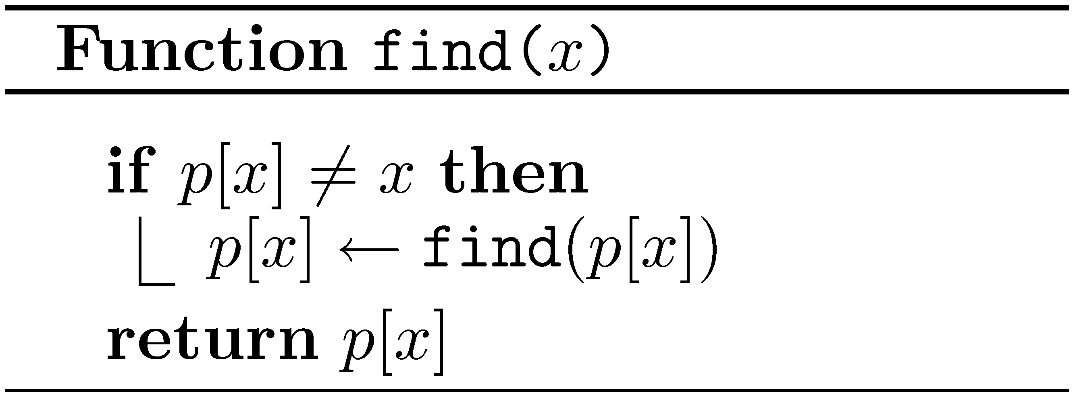
Union Find - pseudocode

Slide 12
Union-Find
Worst case
make | link | find
O(1) | O(1) | O(log n)
Amortized
make | link | find
O(1) | O(α(n)) | O(α(n))

Slide 13
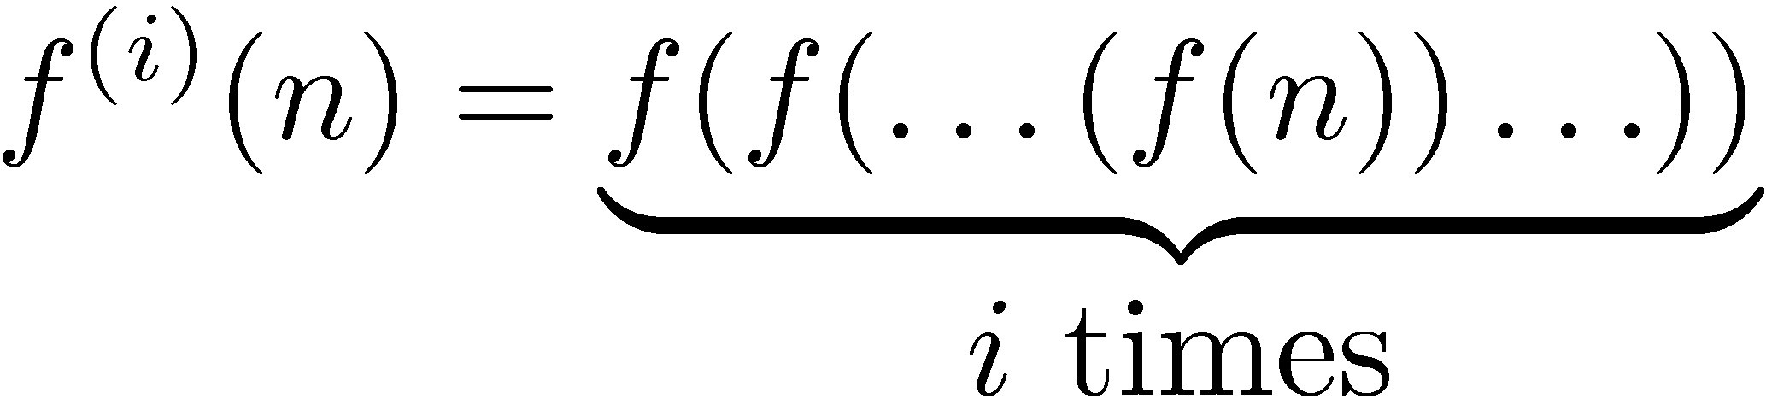
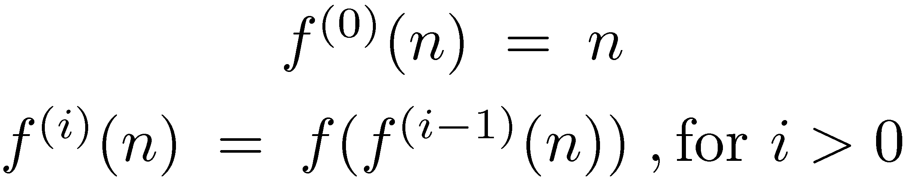
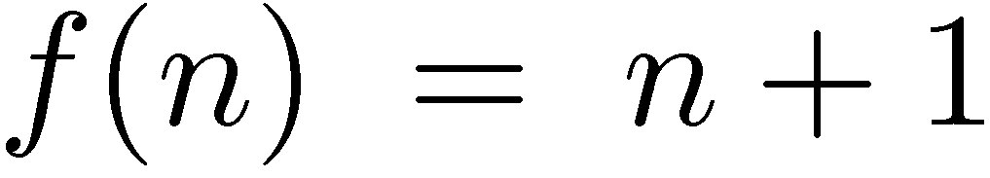
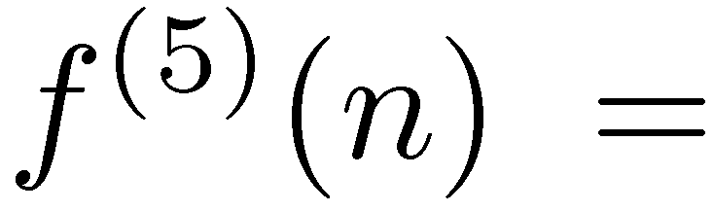
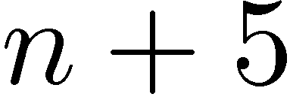
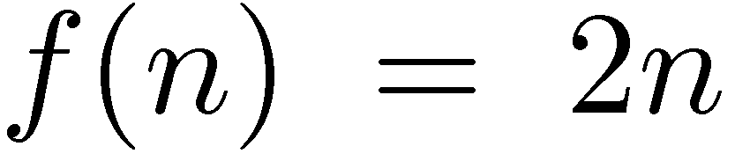
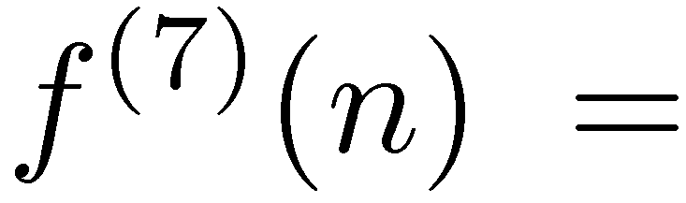
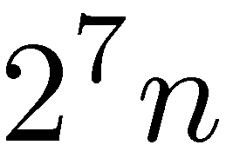
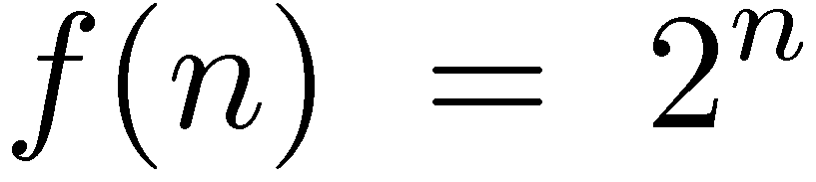
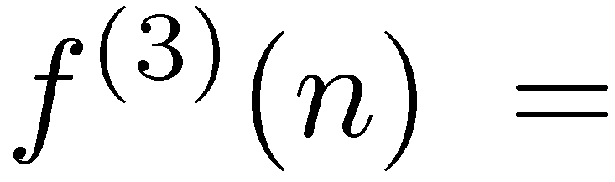
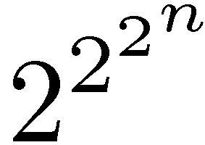
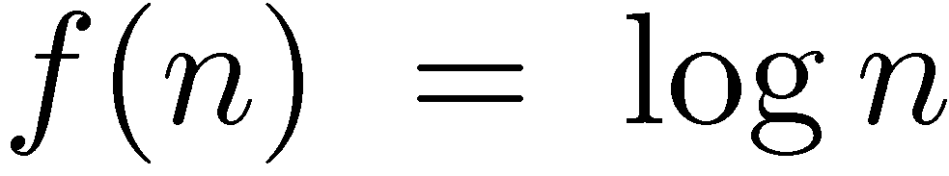
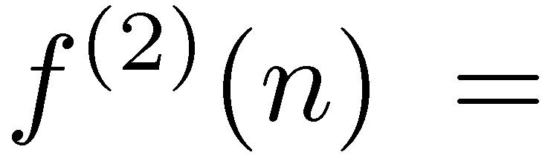
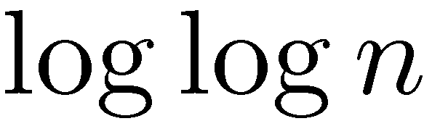
Nesting / Repeated application

Slide 14
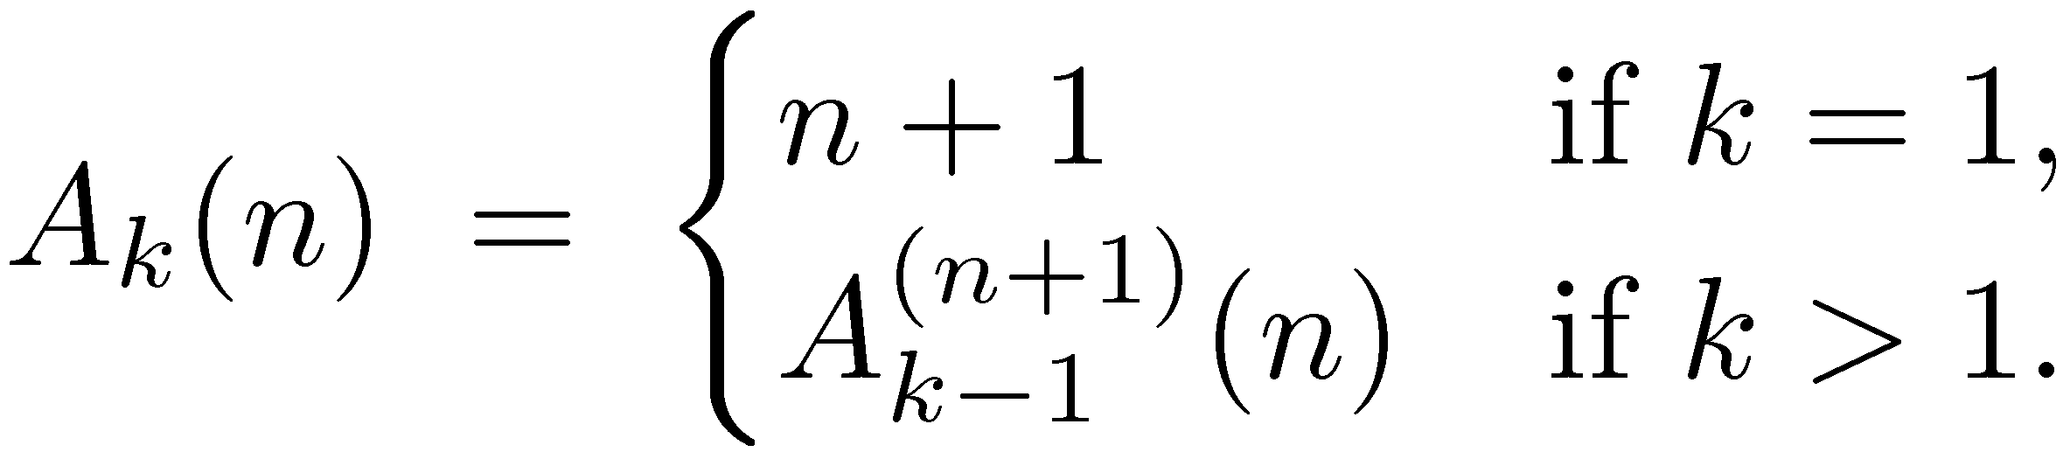
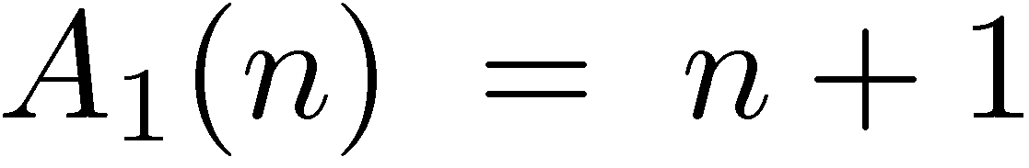
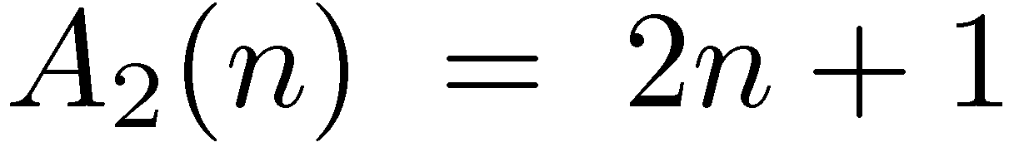
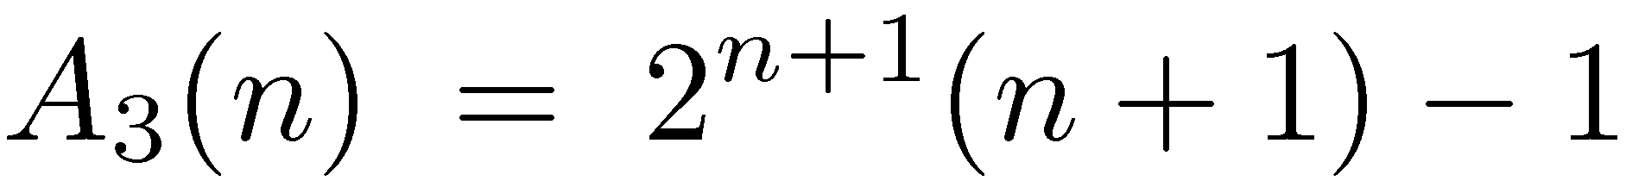
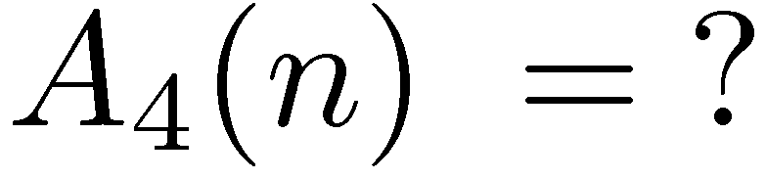
Ackermann’s function

Slide 15

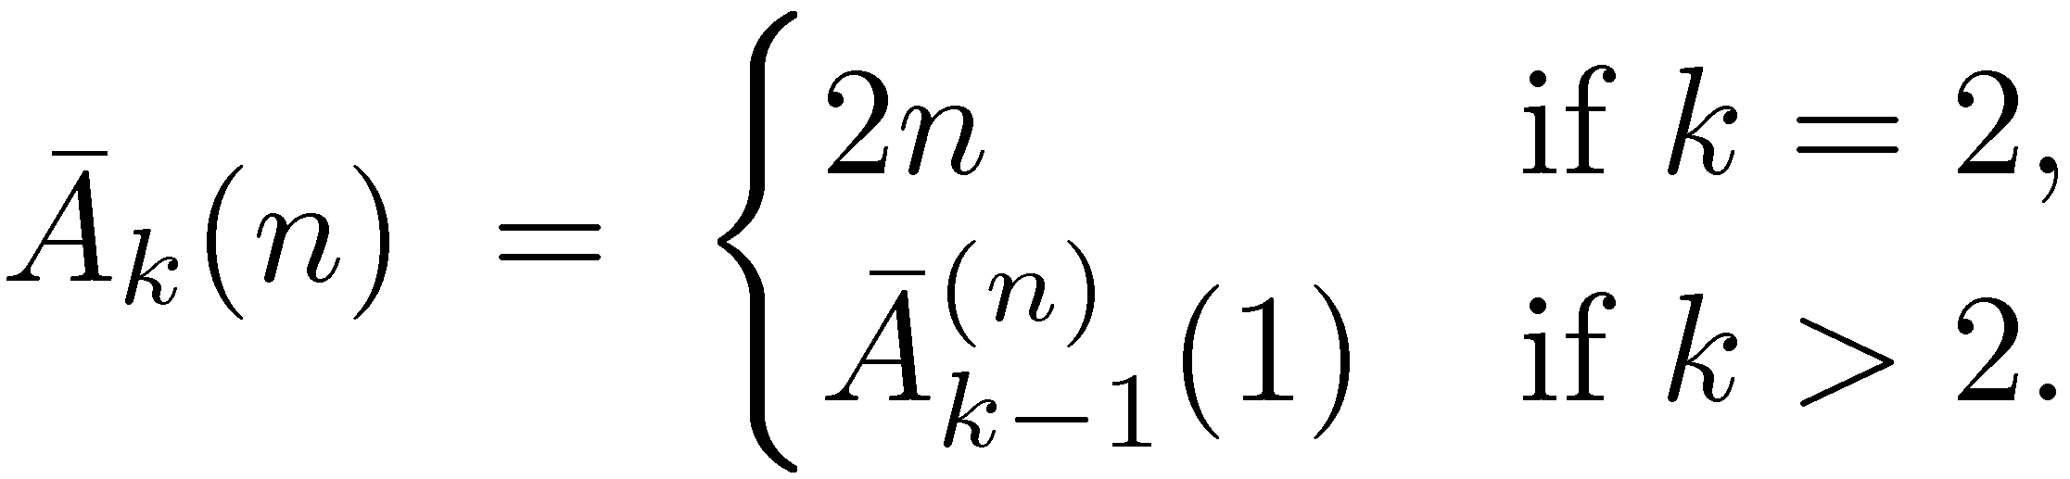
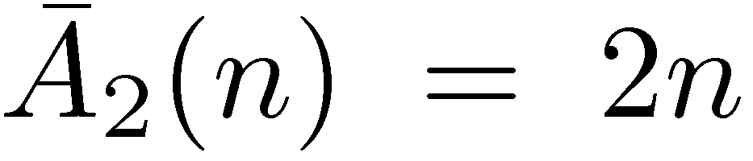
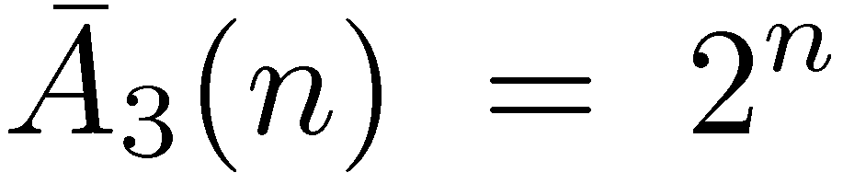
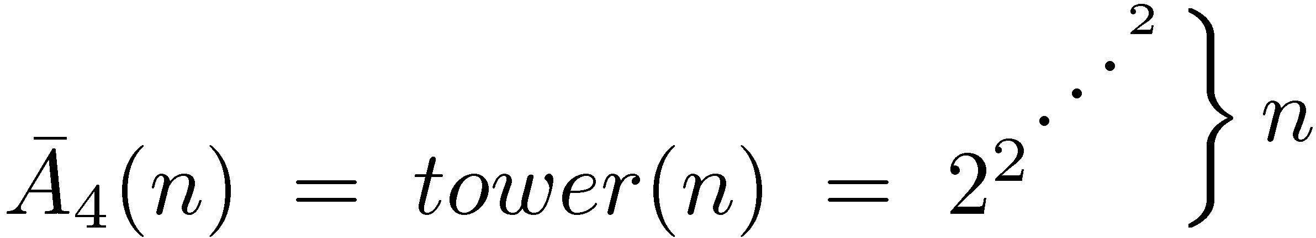
Ackermann’s function (modified)

Slide 16
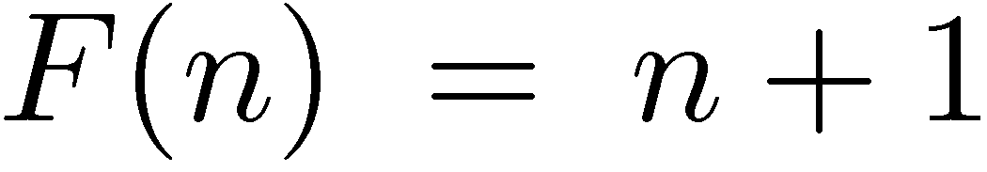
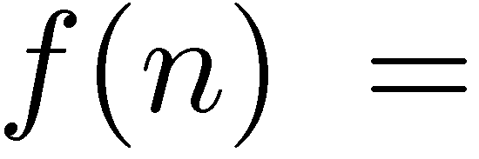
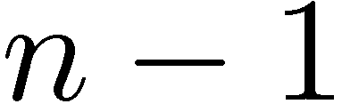
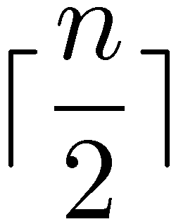
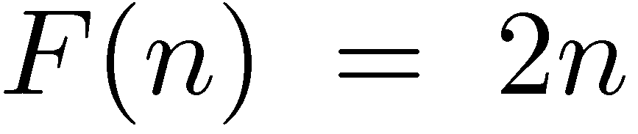
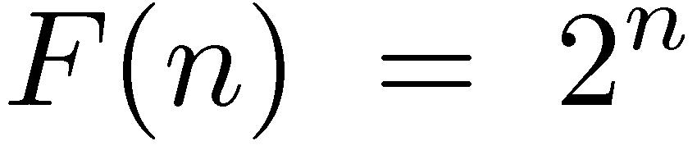
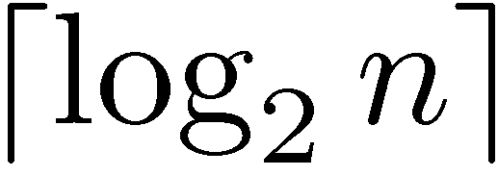
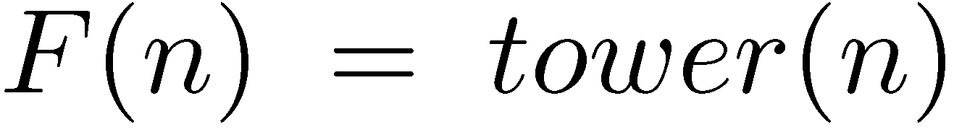
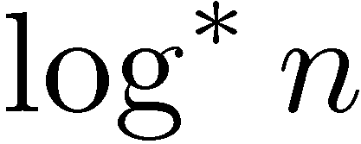
Inverse functions

Slide 17
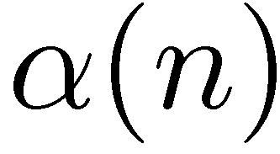
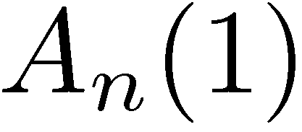
Inverse Ackermann function
is the inverse of the function
A “diagonal”
The first “column”

Slide 18
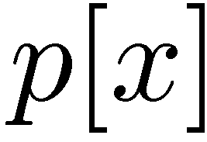

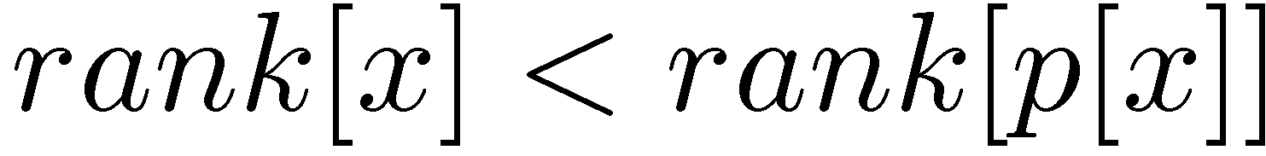
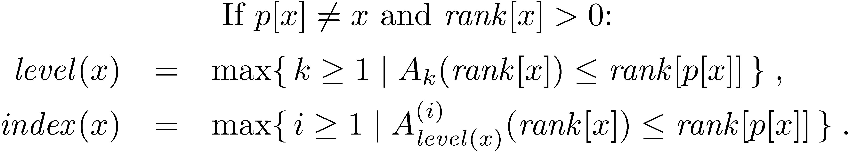
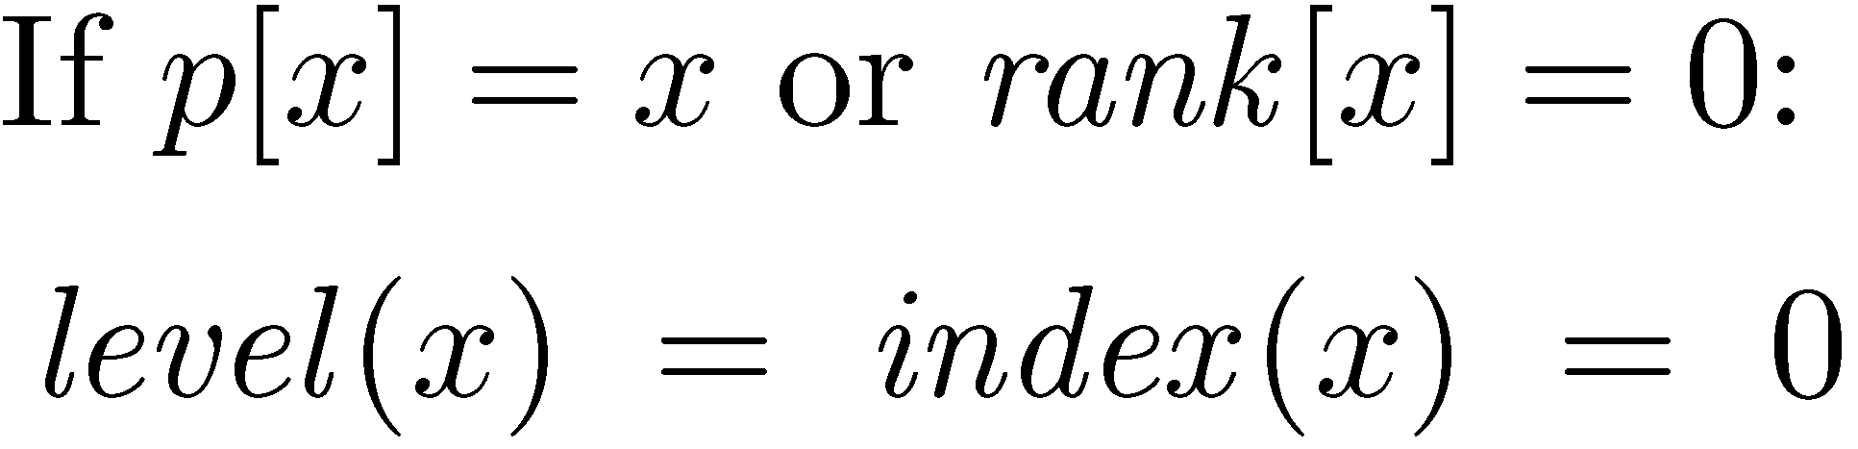
Level and Index
Back to union-find…

Slide 19
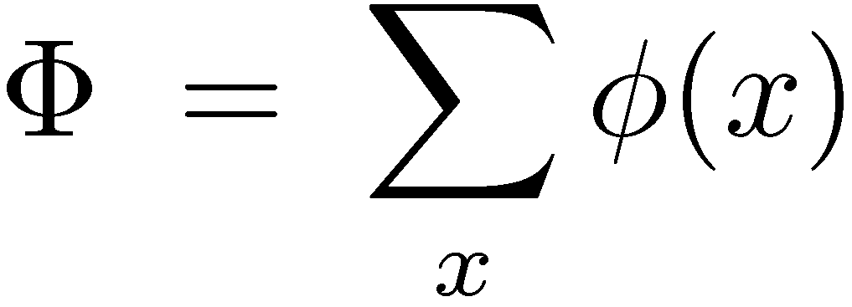
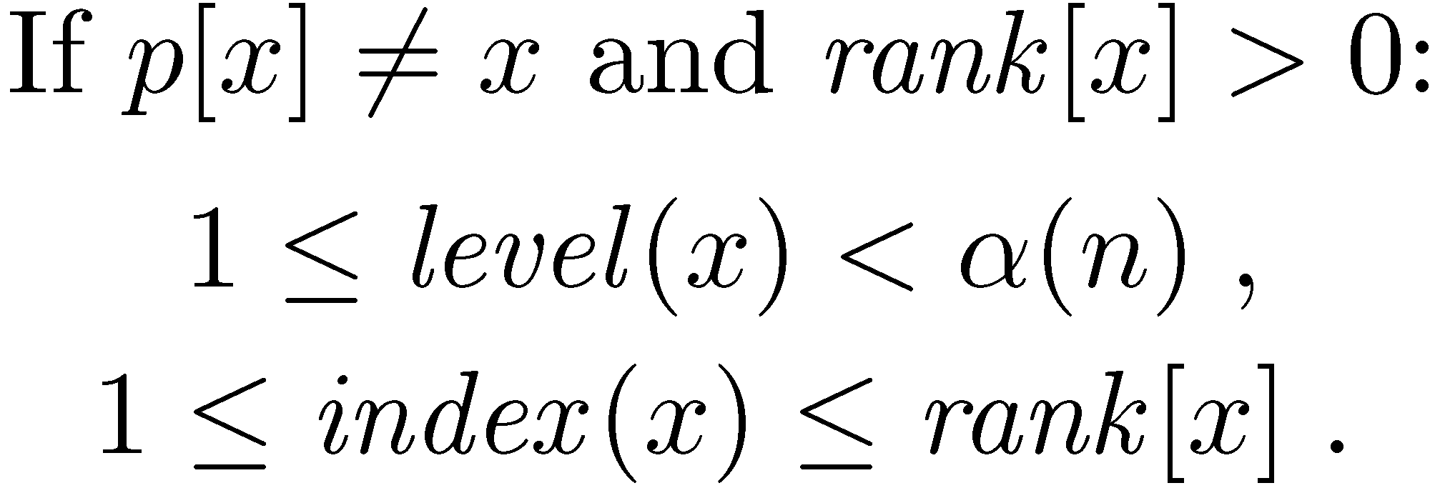
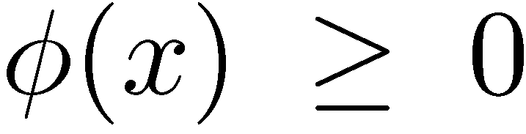
Potentials

Slide 20
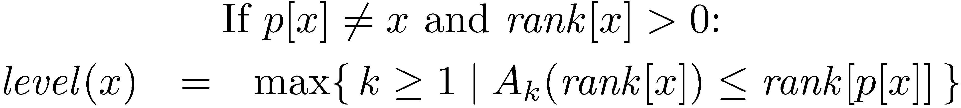
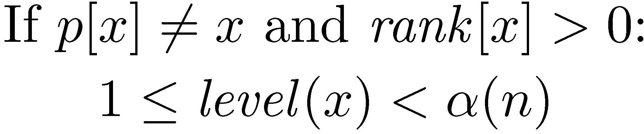
Bounds on level
Definition
Proof
Claim

Slide 21
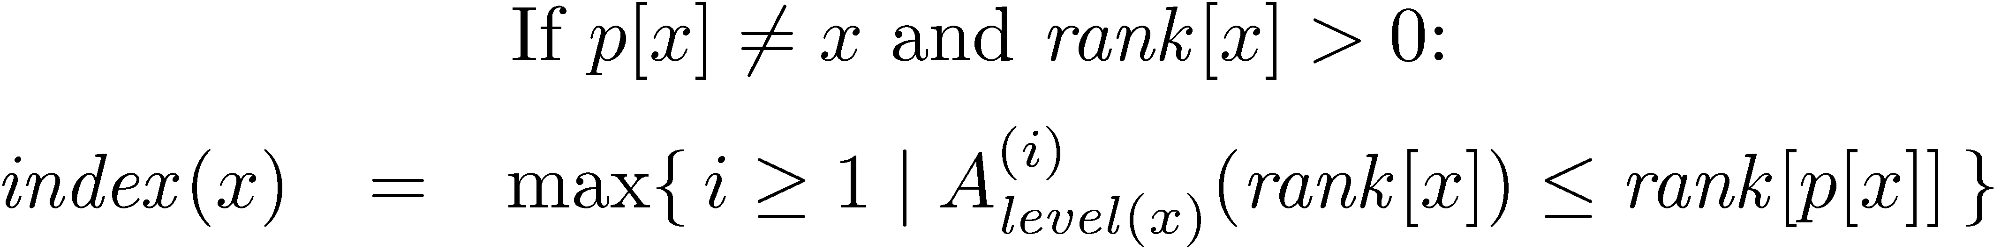
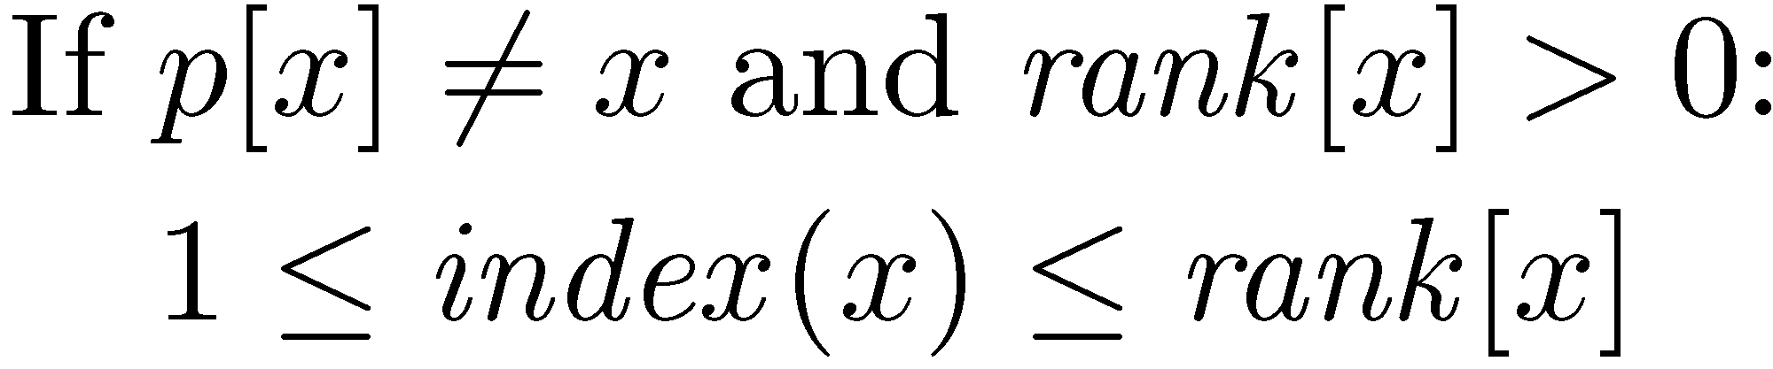
Bounds on index

Slide 22
Amortized cost of make
Actual cost: O(1)
ΔΦ: 0
Amortized cost: O(1)

Slide 23
Amortized cost of link
x
y
Actual cost: O(1)
z₁
…
z_{k}
The potentials of y and z₁,…,z_{k} can only decrease
The potentials of x is increased by at most α(n)
ΔΦ ≤ α(n)
Actual cost: O(α(n))

Slide 24
Amortized cost of find
y=p’[x]
rank[x] is unchanged
rank[p[x]] is increased
level(x) is either
unchanged or is increased
p[x]
If level(x) is unchanged, then index(x) is either unchanged or is increased
x
If level(x) is increased, then index(x) is decreased by at most rank[x]–1
is either unchanged or is decreased

Slide 25



Amortized cost of find
Suppose that:
x_{l}
x_{j}
x_{i}
x=x₀
φ(x) is decreased !

Slide 26
Amortized cost of find
x_{l}
x_{j}
x_{i}
The only nodes that can
retain their potential are:
the first, the last and the
last node of each level
x=x₀
Actual cost: l +1
ΔΦ ≤ (α(n)+1) – (l +1)
Amortized cost: α(n)+1

